Slide 1





Google Forms Clone
Go Forms
Arsh Maknojia Parth Mane

Slide 2

Features Available
Home Page
Form Creation
View Responses
Answer Questions

Slide 3
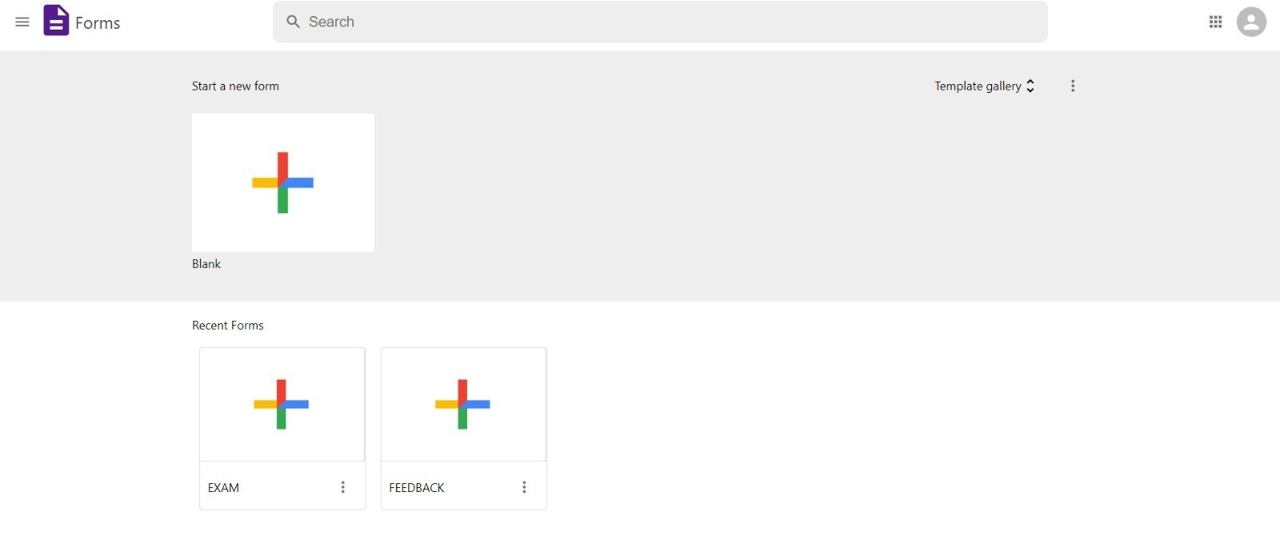
Home Page

Slide 4
Form Creation
Users can ask for feedback or survey or take tests… The possibilities are endless…
Only MCQ’s supported as of now.
Easily scalable to other forms of questions.

Slide 5
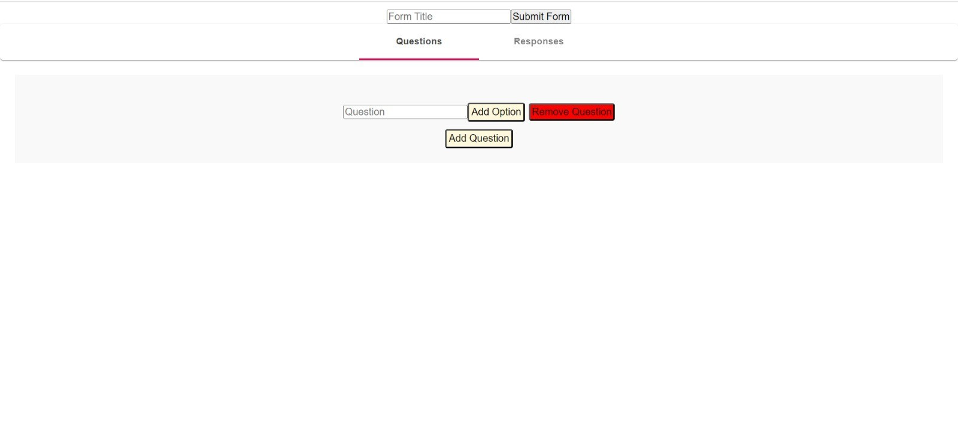
Form creation

Slide 6

Easy to create and edit forms
See all responses
Create Questions
Create and share link
PRESENTATION TITLE
6

Slide 7

Respond to forms created by others

Slide 8
Language and Tools used
Language
JavaScript
React.js
Tools
VS Code
Git GitHub
NPM Packages
PRESENTATION TITLE
8

Slide 9





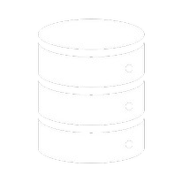
OOPS and Android Concepts used
CLASSES AND OBJECTS IMPLEMENTED
INHERITARNECYEC, LER VIEW ABSTRACTION,
ENCAPSULATION, INTERFERENCE AND
POLYMORPHISM
DATABASE
PDF GENERATOR
9

Slide 10



Thank you

